Slide 1

DBMS Project – Group 9
CureConnect: Empowering Health, Connecting Lives
By
ARISHA JAMAL (2241010)
EDWIN SHAJAN (2241015)
KSHITIJ SAKHUJA (2241028)
Under the supervision of
DR. FABIOLA HAZEL POHRMEN
MISSION
CHRIST is a nurturing ground for an individual’s holistic development to make effective contribution to the society in a dynamic environment
VISION
Excellence and Service
CORE VALUES
Faith in God | Moral Uprightness Love of Fellow Beings
Social Responsibility | Pursuit of Excellence

Slide 2
Agenda
CHRIST
Deemed to be University
Introduction
Objectives
Sustainable Development Goals Alignment
Existing Systems
Their Limitations
Proposed System
Data Flow Diagram
E-R Diagram
Schema Diagram
Project Screens
Demo
References

Slide 3
Introduction
CHRIST
Deemed to be University
Revolutionizing Healthcare: CureConnect is a web application to transform healthcare access, appointment scheduling, and medical record management.
Aligned with SDG 3: Committed to Sustainable Development Goal 3, CureConnect simplifies the healthcare journey, empowers patients, and ensures robust data security.
Comprehensive Platform: Equipped with diverse modules, CureConnect enhances healthcare services, contributing to the overall well-being of individuals.
Addressing Limitations: CureConnect overcomes existing system limitations, introducing innovative solutions for a more user-centric healthcare experience.
Future of Healthcare Technology: As a beacon of transformation, CureConnect envisions a future where healthcare is not only efficient but profoundly user-centric.

Slide 4
Objectives
CHRIST
Deemed to be University
Enhance User Experience: Improve the overall user experience through efficient tools for finding and scheduling appointments.
Digital Health Management: Facilitate the adoption of digital health management by enabling secure storage of medical records.
Informed Decision-Making: Enhance access to essential healthcare information through a comprehensive database of facilities.
Data Privacy and Security: Uphold user trust by ensuring robust data privacy and security measures.
Personalization: Empower individuals to personalize their healthcare experience through profile management.

Slide 5
CHRIST
Deemed to be University
Community Engagement: Foster a sense of trust and community through user reviews, ratings, and forums.
Transparency in Healthcare: Provide detailed profiles of healthcare professionals for informed decision-making.
Accessibility Across Languages: Broaden website reach with multi-language support.
Accessibility to Medical Resources: Promote accessibility to necessary healthcare resources.
User-Friendly Experience: Ensure a user-friendly experience through assistance, FAQs, and intuitive navigation.
Inclusive Accessibility Features: Implement features like screen reader compatibility and adjustable font sizes for inclusivity.

Slide 6
Sustainable Development Goals Alignment:
CHRIST
Deemed to be University
SDG 3: Good Health: Improve healthcare access and streamline services for healthier lives.
SDG 9: Innovation: Utilize tech innovations for efficient healthcare solutions.
SDG 10: Inequality Reduction: Address healthcare disparities for more equitable services.
SDG 16: Data Security: Uphold data security and privacy for trustworthy healthcare.
SDG 17: Collaborative Partnerships: Foster collaborations for impactful healthcare advancements.

Slide 7
Existing Systems
CHRIST
Deemed to be University
Practo: Leading app for online doctor consultations and healthcare services, offering efficient appointment booking and access to health records.
mfine: A powerful platform providing online consultations, prescriptions, and medicine orders.
MediBuddy: Connects users with specialist doctors, enabling video consultations and personalized treatment plans.
1mg: Comprehensive health platform covering disease info, medicines, and diagnostic resources.
Fortis Hospital: User-friendly website for booking appointments with multilingual support, lacking virtual consultation.

Slide 8
Their Limitations
CHRIST
Deemed to be University
Limited Language Support: Inadequate language support affects user engagement.
Absence of User Forum: Platforms lack a dedicated forum for user feedback and community engagement.
Accessibility Features Missing: High-contrast UI and font size customisation are absent, impacting users with visual preferences.
Limited Review Sections: Insufficient designated review areas for comprehensive user feedback, affecting prospective patients.

Slide 9
Proposed System: Modules and Functionality
CHRIST
Deemed to be University
Appointment Scheduling:
Find nearby healthcare facilities.
Real-time scheduling with reminders.
Multi-Language Support:
Broadens platform reach with multiple languages.
Help/FAQ/Navigation:
User-friendly assistance.
Medical Records Management:
Digitized storage of medical records.
Supports informed decision-making.

Slide 10
CHRIST
Deemed to be University
Healthcare Facility Information:
A comprehensive database of facilities.
Precise information with user reviews.
User Authentication and Security:
Ensures privacy and security compliance.
User Profile:
Secure profile management.
Stores insurance and user preferences.
Reviews/Forum:
Enables user feedback and community engagement.
Professional Profiles:
Detailed profiles of healthcare professionals.

Slide 11
CHRIST
Deemed to be University
Accessibility Features:
Features for diverse user needs.
Disease Catalog:
Comprehensive health information for users.

Slide 12
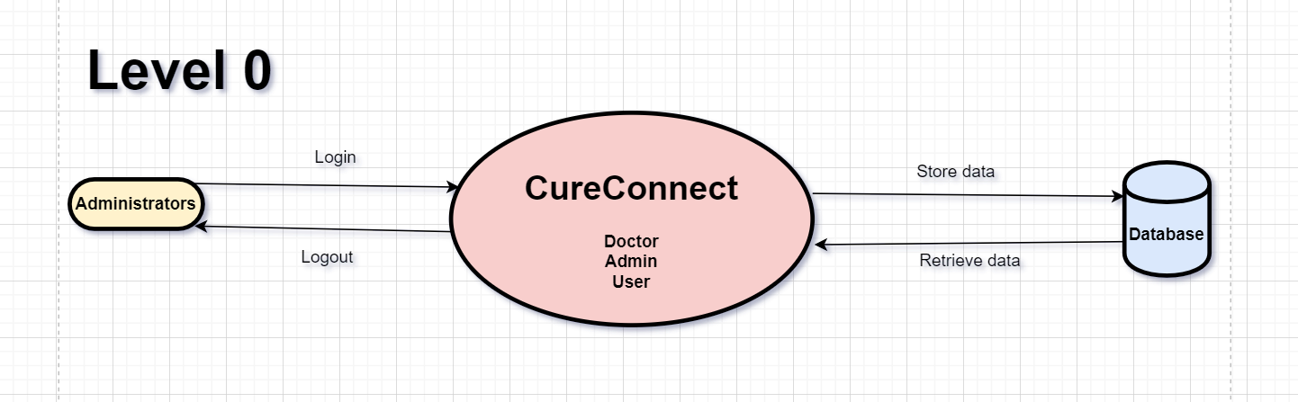
Data Flow Diagram
CHRIST
Deemed to be University

Slide 13
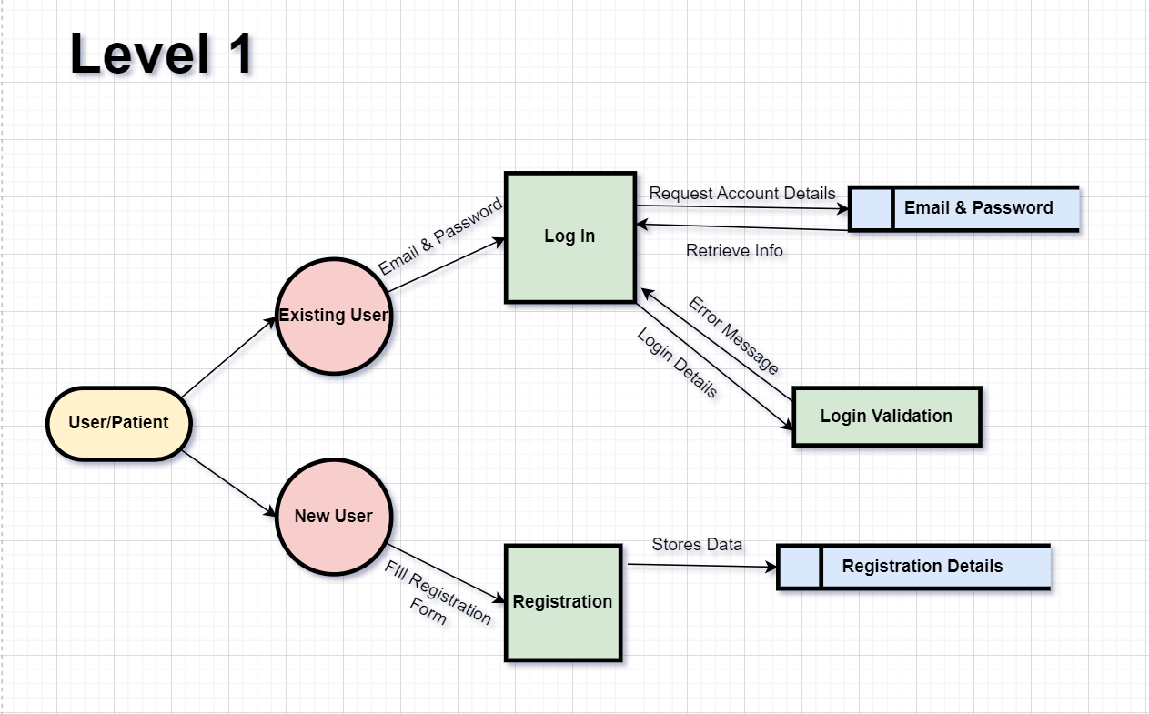
CHRIST
Deemed to be University

Slide 14
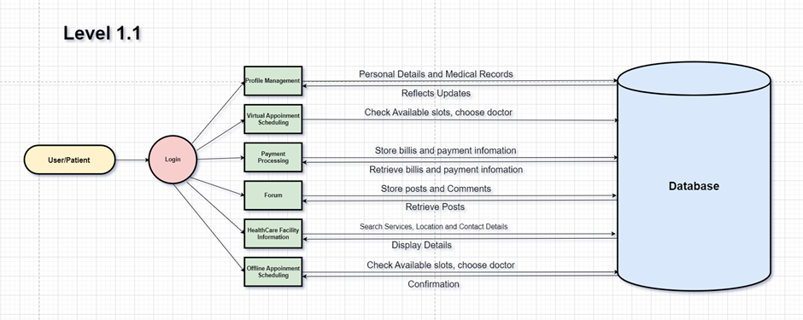
CHRIST
Deemed to be University

Slide 15
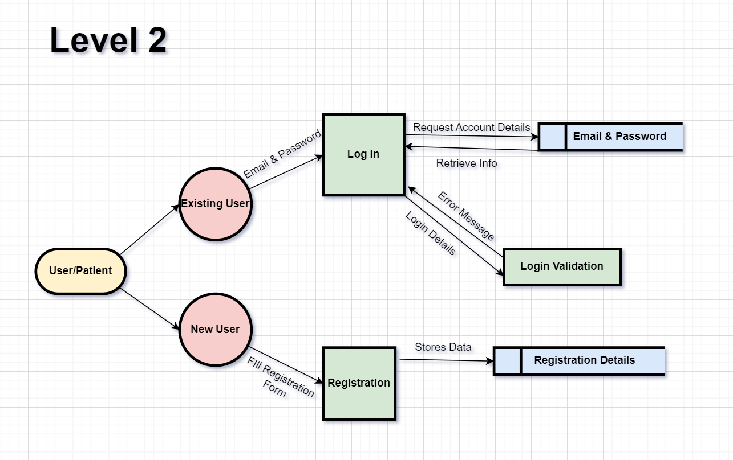
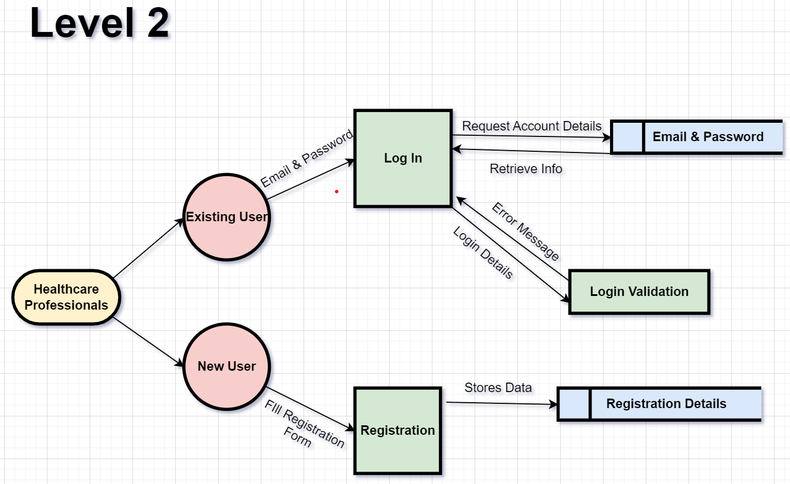
CHRIST
Deemed to be University

Slide 16
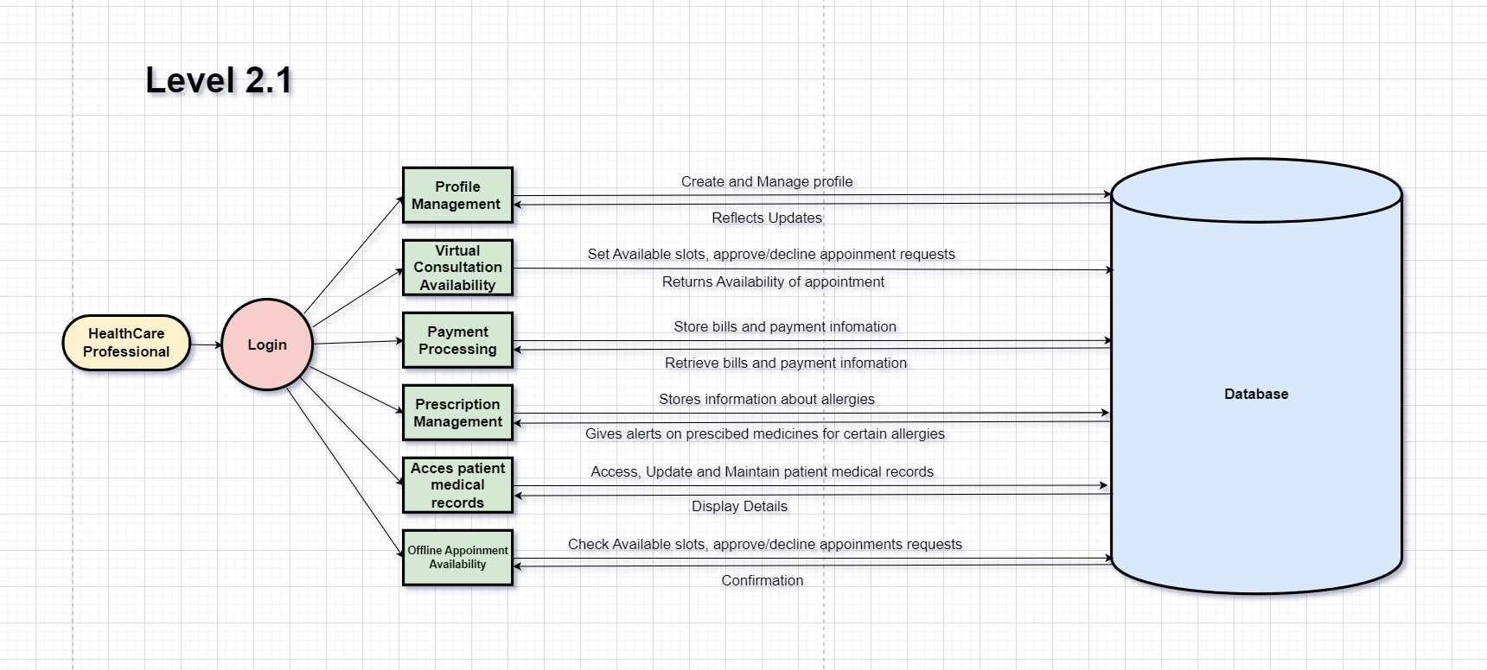
CHRIST
Deemed to be University

Slide 17
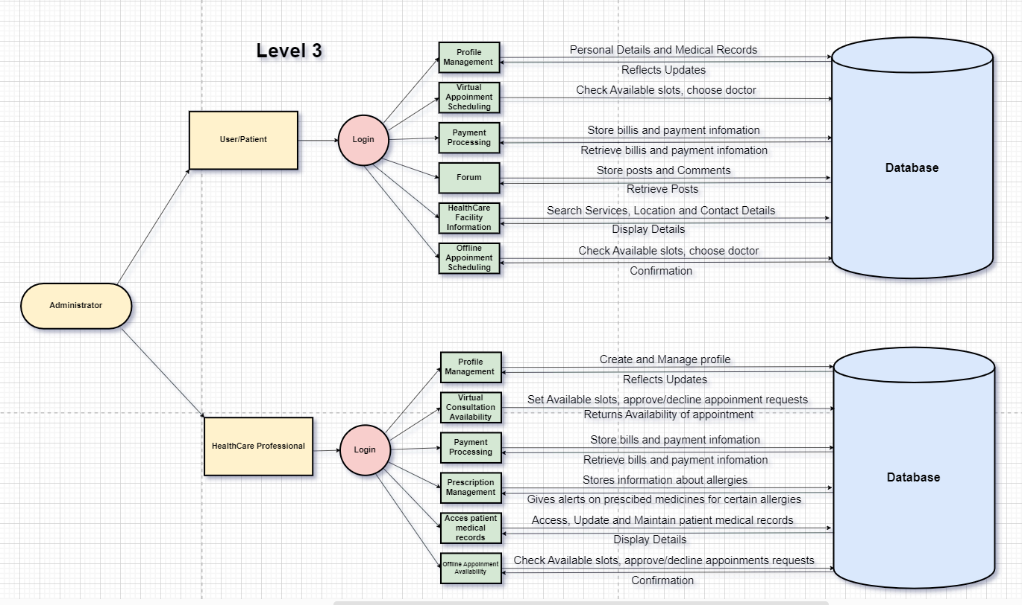
CHRIST
Deemed to be University

Slide 18
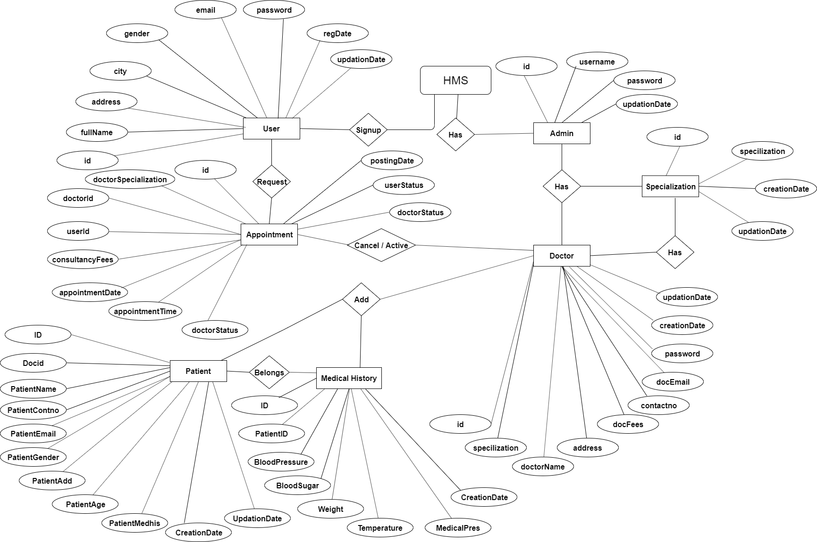
E-R Diagram
CHRIST
Deemed to be University

Slide 19
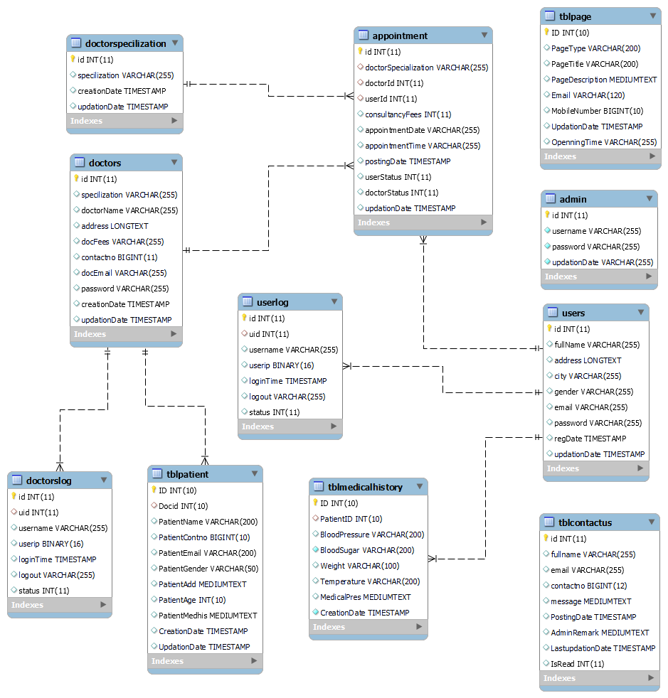
Schema Diagram
CHRIST
Deemed to be University

Slide 20
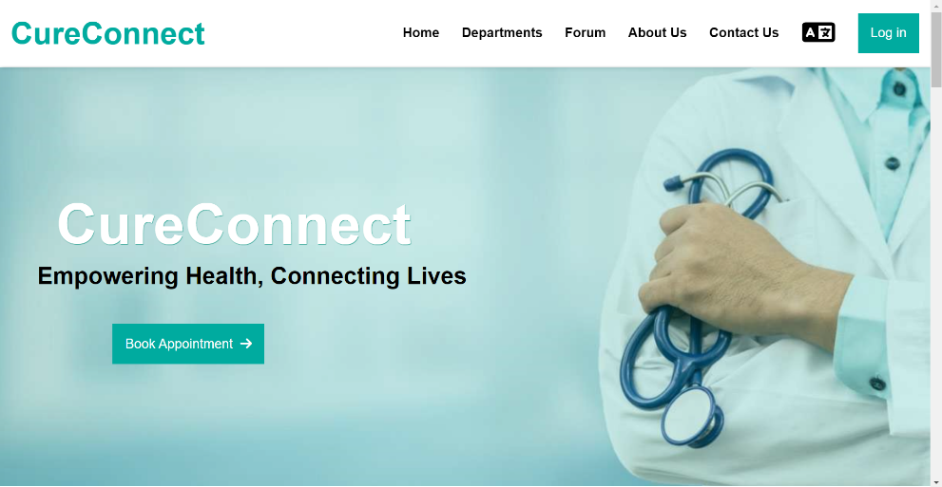
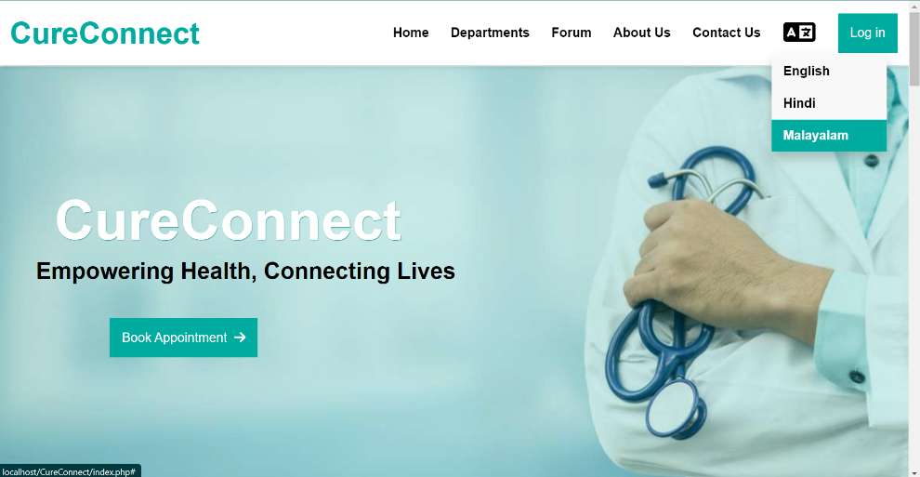
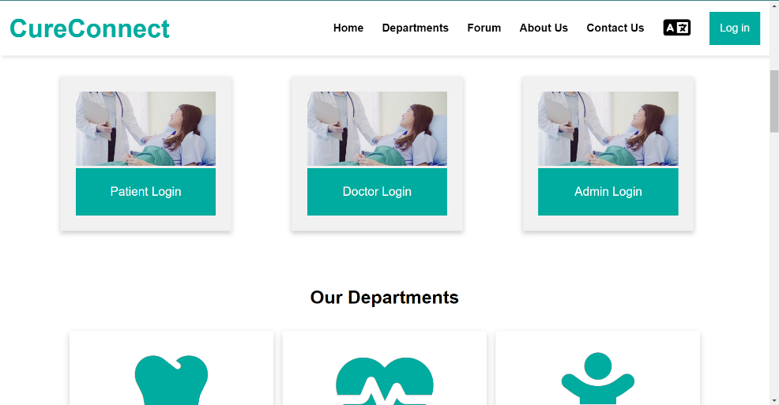

Project Screens

Slide 21
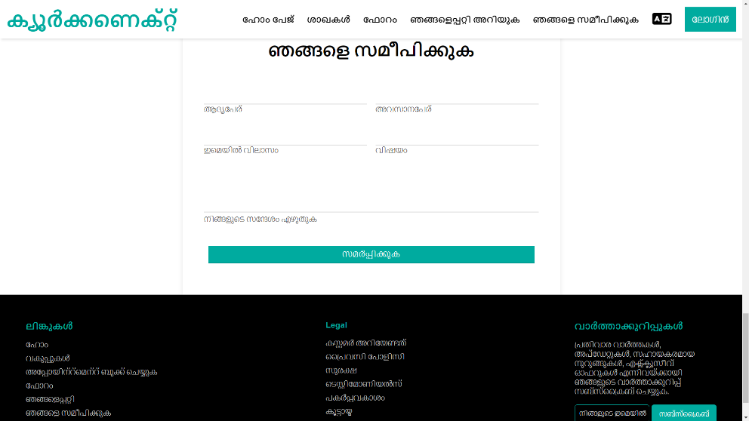
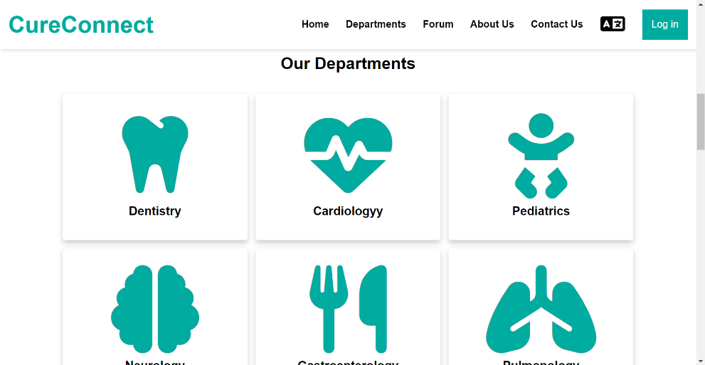
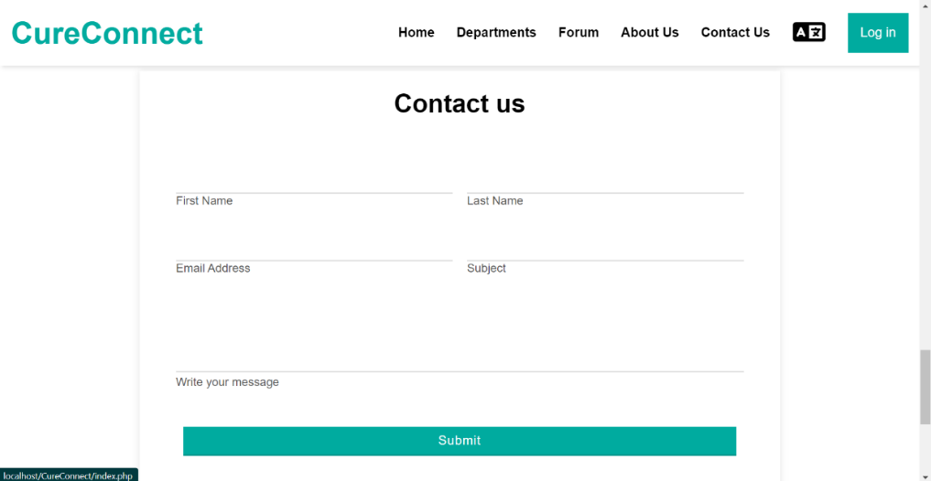
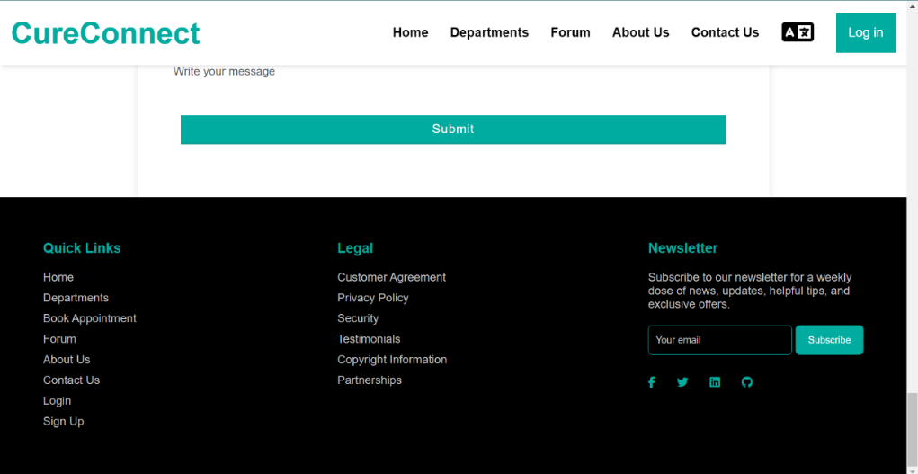

Slide 22
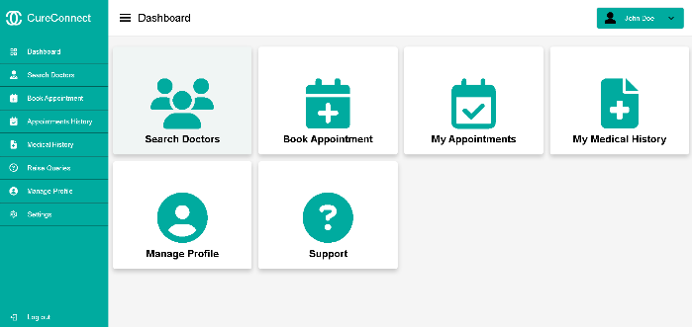
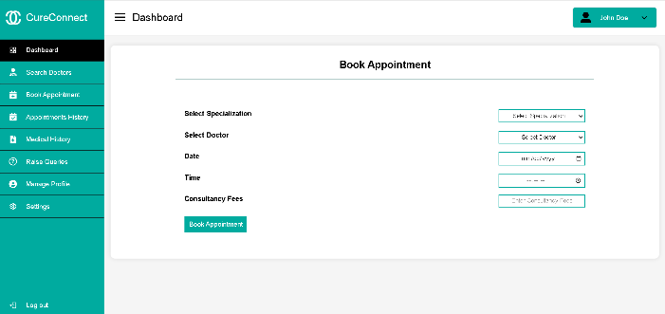
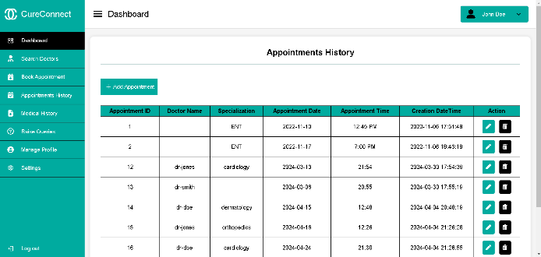
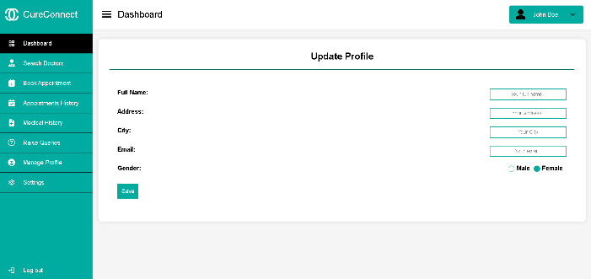
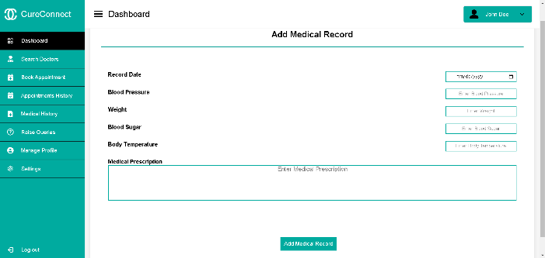
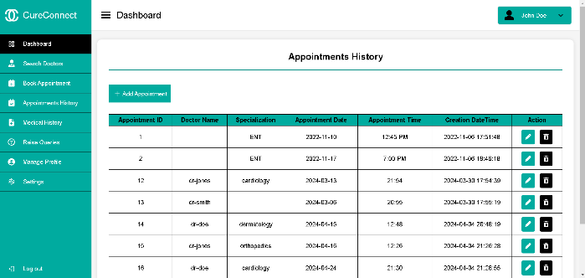
CHRIST
Deemed to be University

Slide 23
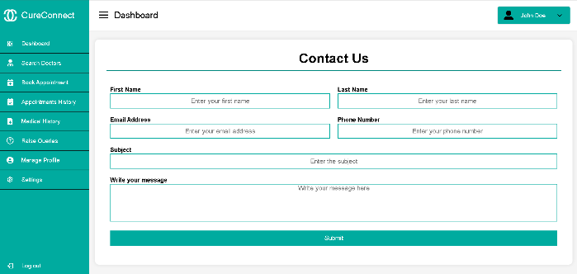
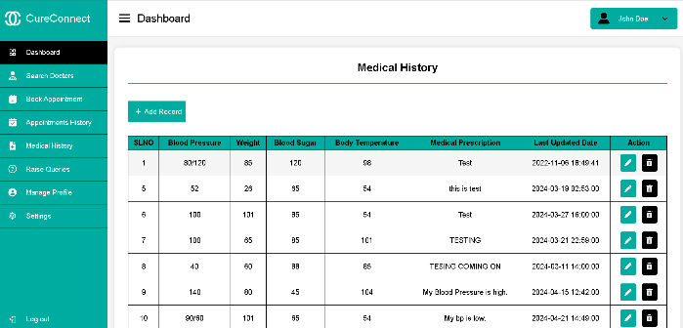
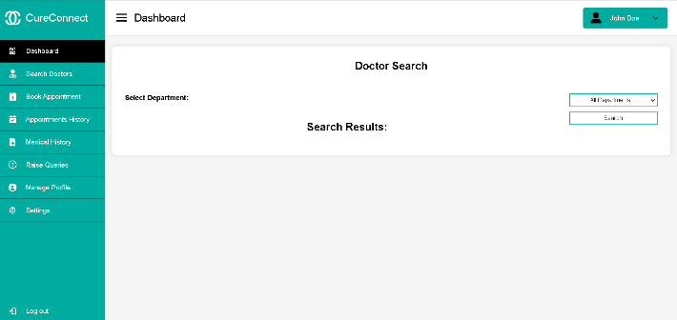
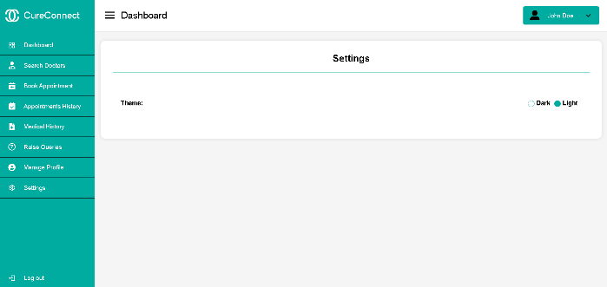
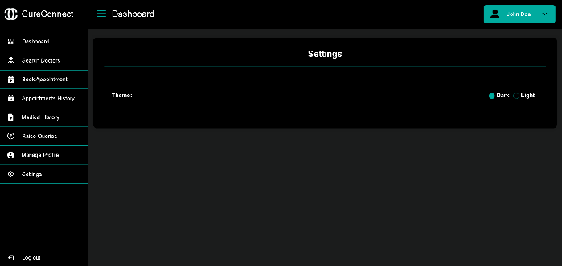
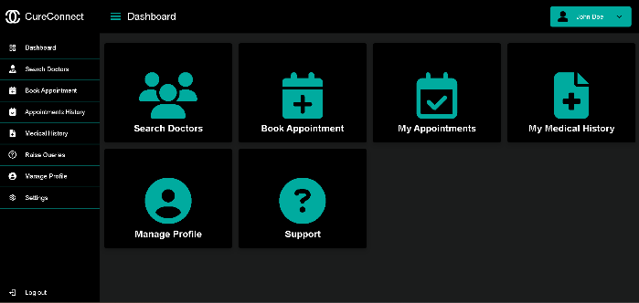
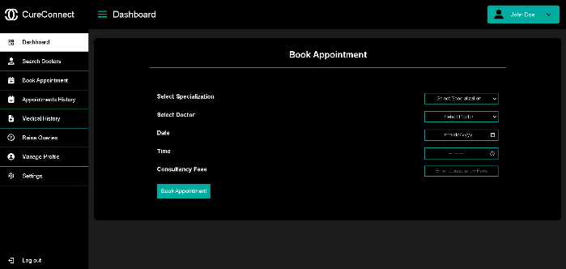
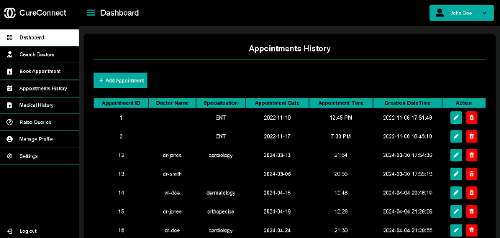
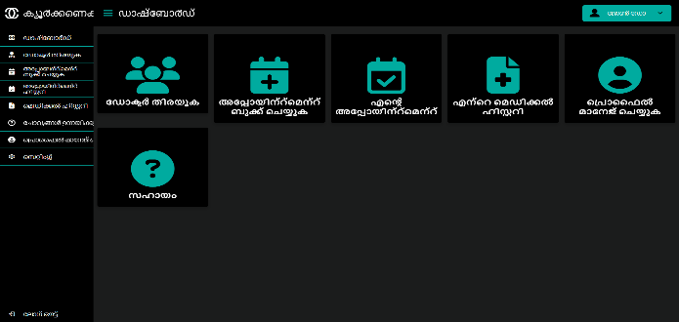

Slide 24
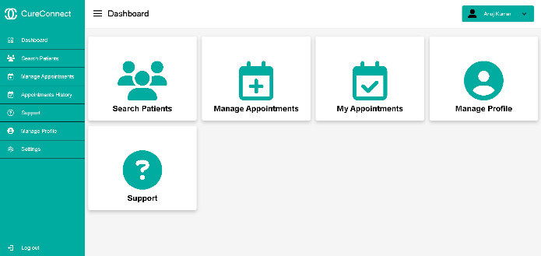
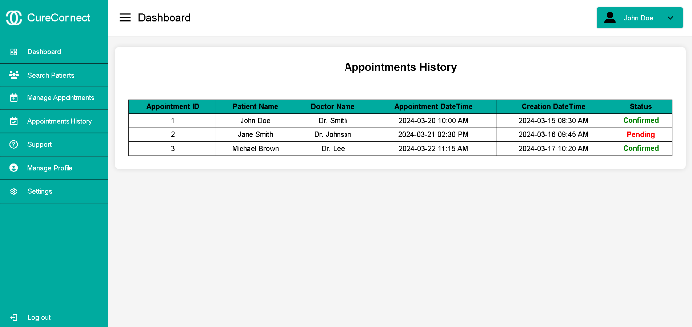
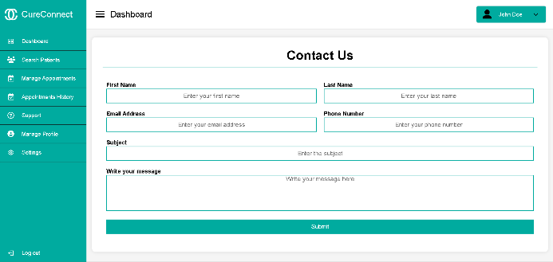
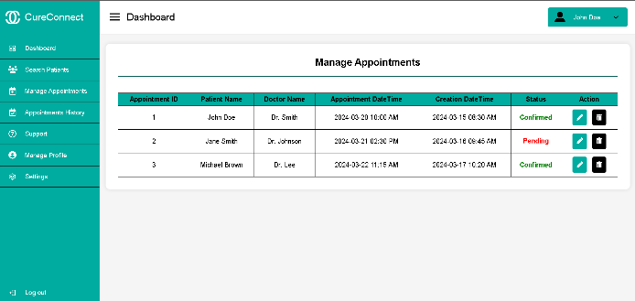
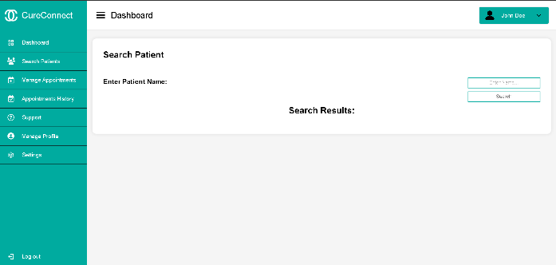

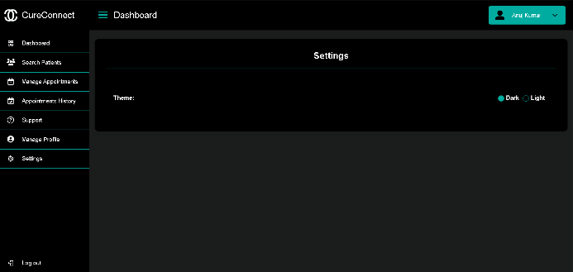
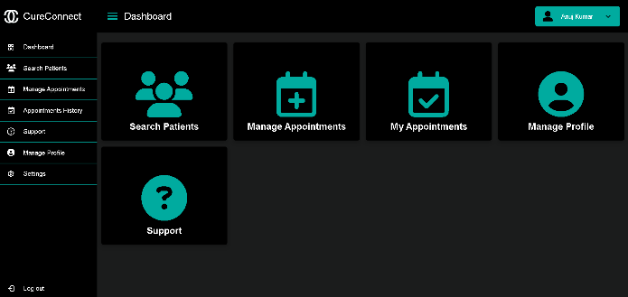
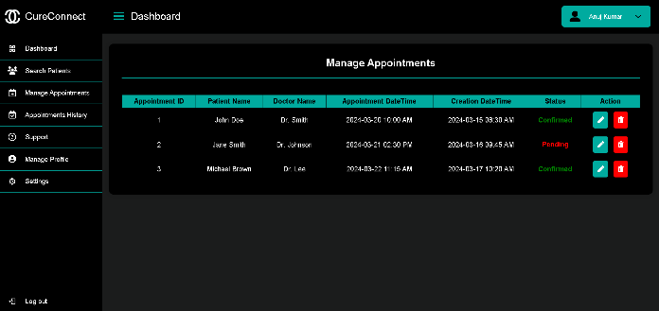

Slide 25
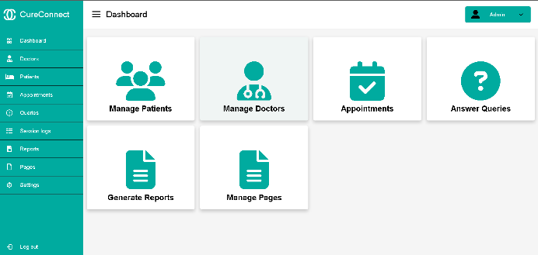
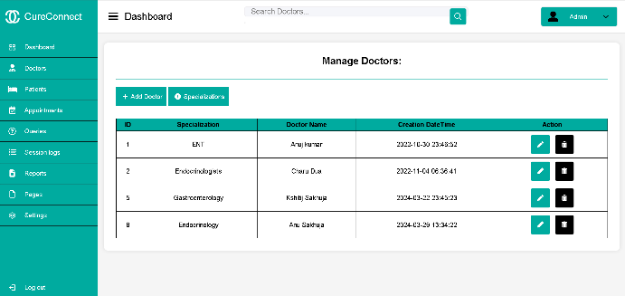
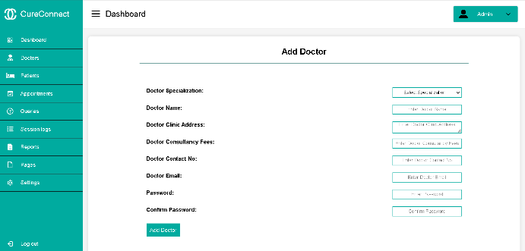
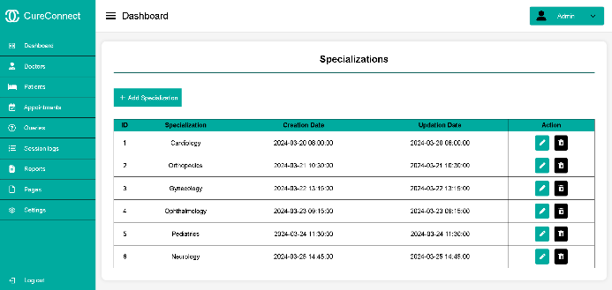
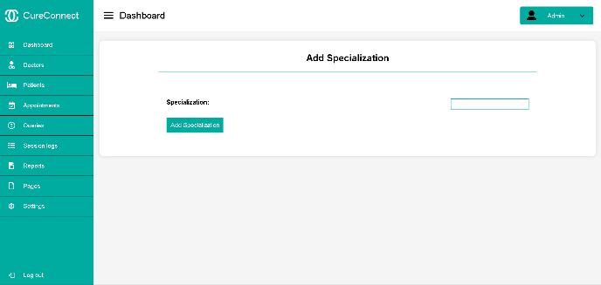
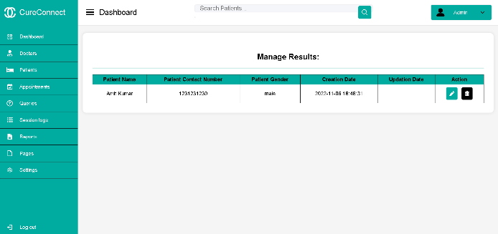
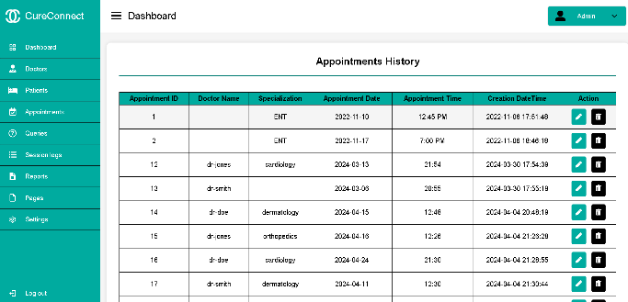
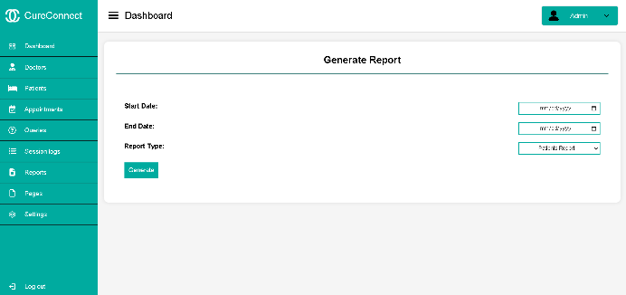
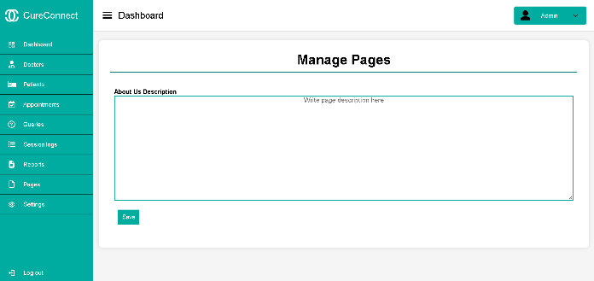

Slide 26
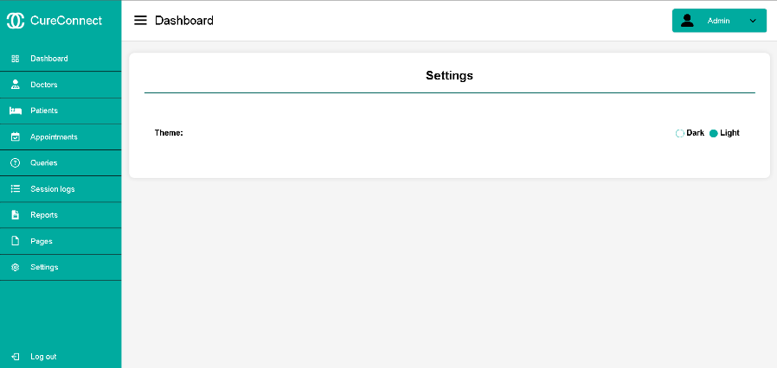
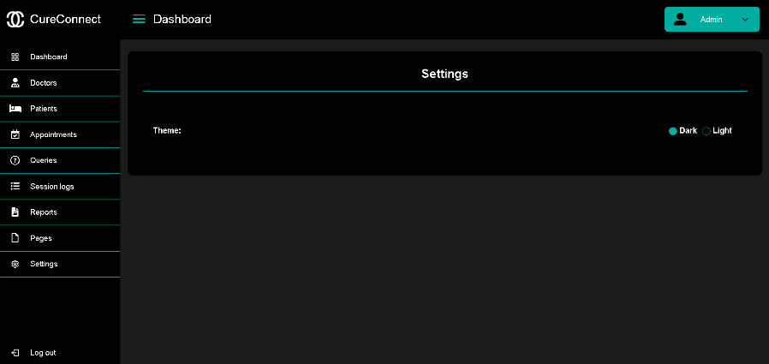



Slide 27
References
CHRIST
Deemed to be University
www.dbswebsite.com
www.webalive.com.au
www.ijraset.com
www.medibuddy.in
www.corporate.mfine.in
www.practo.com
www.w3schools.com/php/default.asp
www.php.net/
www.mysql.com/
www.apachefriends.org/download.html

